Slide 1
Housing Price Prediction Analysis

Slide 2
House price prediction
PREDICTORS
DWELL_TYPE
ZONE_CLASS
LOTFRONTAGE
LOTAREA
ROAD_TYPE
ALLEY
PROPERTY_SHAPE
LANDCONTOUR
UTILITIES
LOTCONFIG
LANDSLOPE
NEIGHBORHOOD
CONDITION1
CONDITION2
DWELLING_TYPE
HOUSESTYLE
OVERALLQUAL
OVERALLCOND
YEARBUILT
YEARREMODADD
ROOFSTYLE
ROOFMATL
EXTERIOR1ST
EXTERIOR2ND
MASVNRTYPE
MASVNRAREA
EXTERQUAL
EXTERCOND
FOUNDATION
BSMTQUAL
BSMTCOND
BSMTEXPOSURE
BSMTFINTYPE1
BSMTFINSF1
BSMTFINTYPE2
BSMTFINSF2
BSMTUNFSF
TOTALBSMTSF
HEATING
HEATINGQC
CENTRALAIR
ELECTRICAL
1STFLRSF
2NDFLRSF
LOWQUALFINSF
GRLIVAREA
BSMTFULLBATH
BSMTHALFBATH
FULLBATH
HALFBATH
BEDROOMABVGR
KITCHENABVGR
KITCHENQUAL
TOTRMSABVGRD
FUNCTIONAL
FIREPLACES
FIREPLACEQU
GARAGETYPE
GARAGEBLT
GARAGEFINISH
GARAGECARS
GARAGEAREA
GARAGEQUAL
GARAGECOND
PAVEDDRIVE
WOODDECKSF
OPENPORCHSF
ENCLOSEDPORCH
THRSSNPORCH
SCREENPORCH
POOLAREA
POOLQC
FENCE
MISCFEATURE
MISCVAL
MOSOLD
YRSOLD
SALETYPE
SALECONDITION

Slide 3
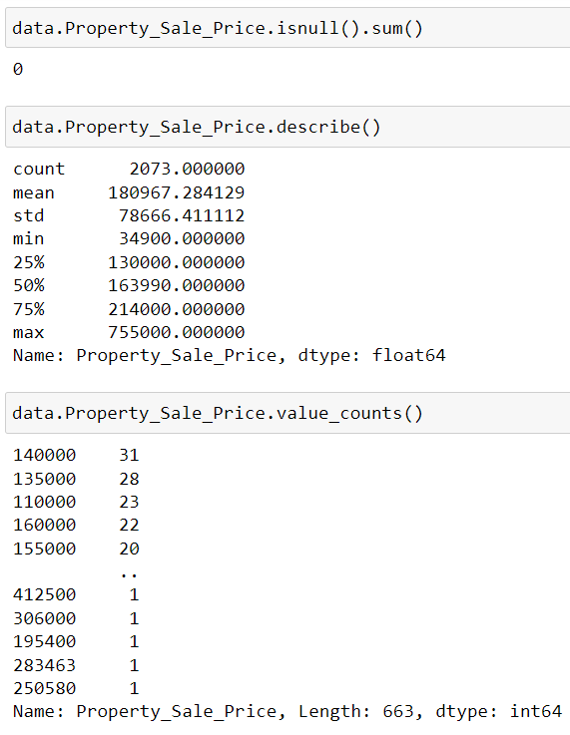
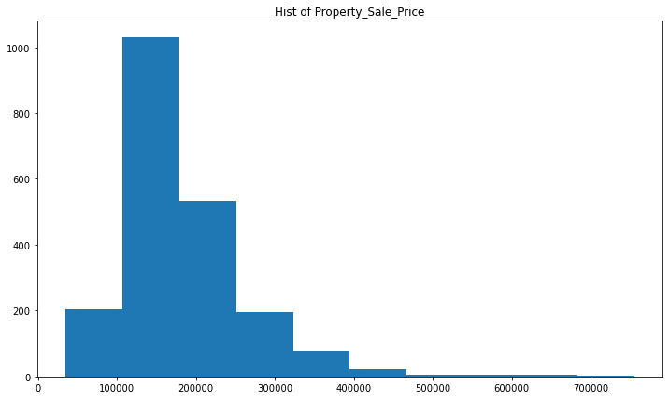
Response / Target Variable Property_Sale_Price
Continuous Variable

Slide 4
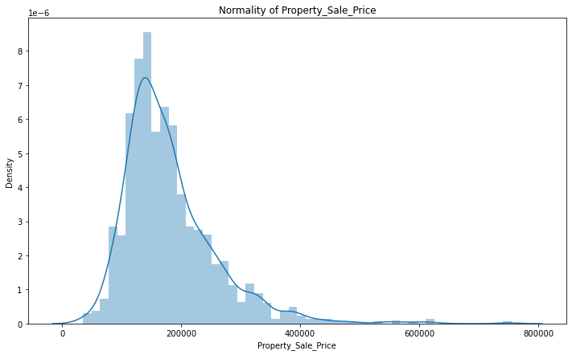
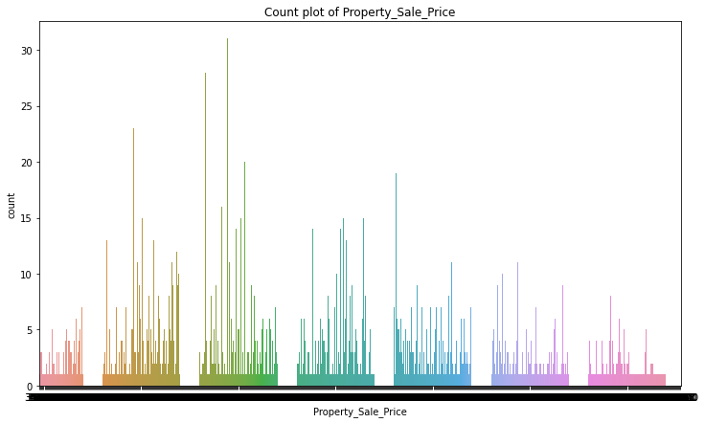
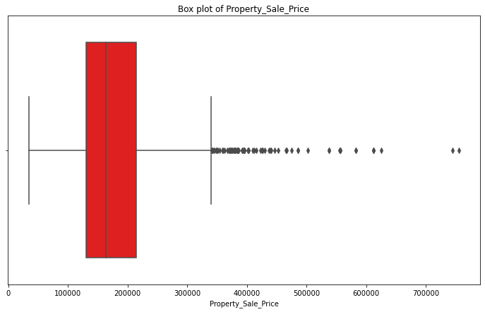

Slide 5
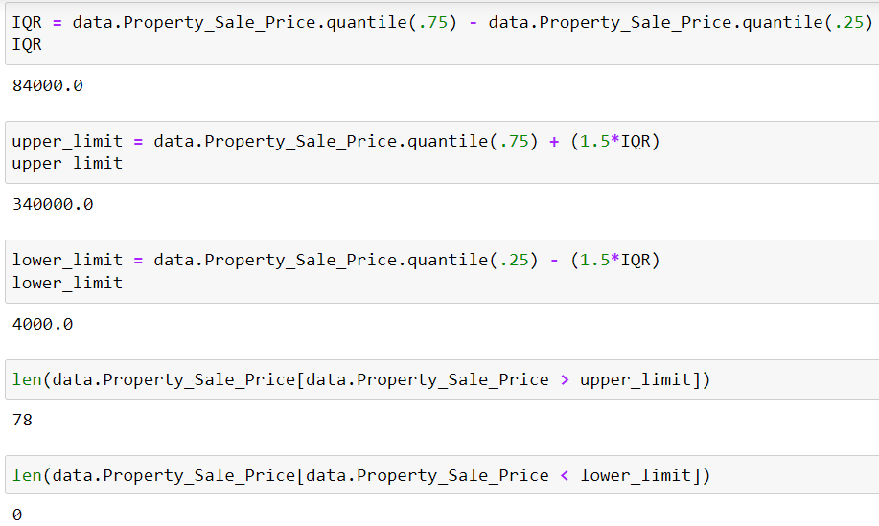
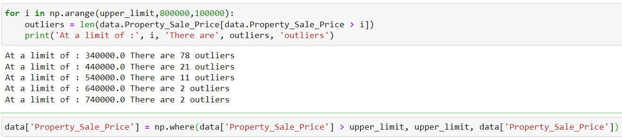
Outlier Treatment

Slide 6
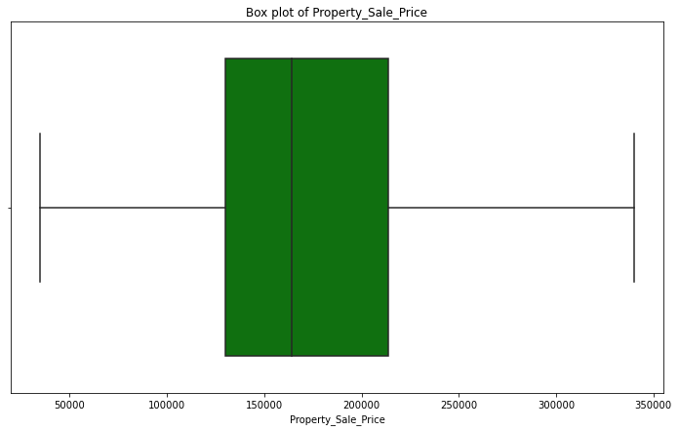
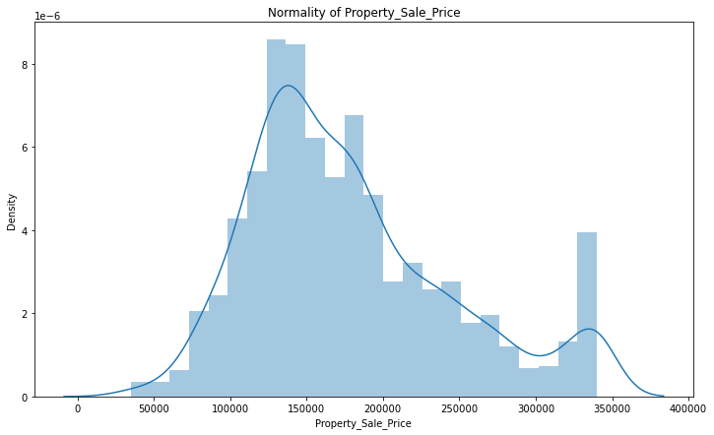
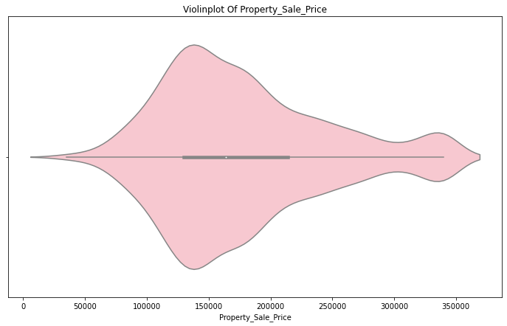

Slide 7
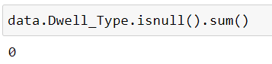
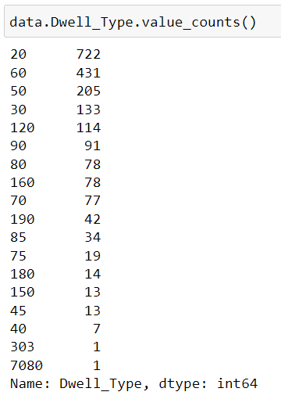
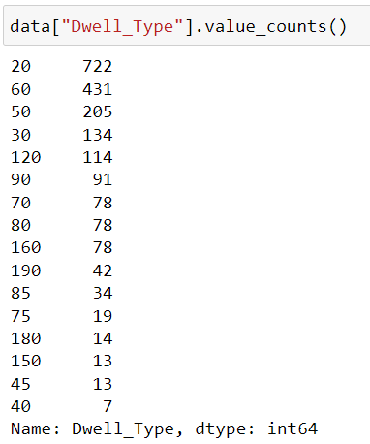
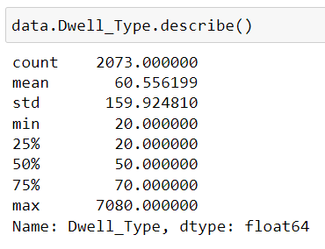
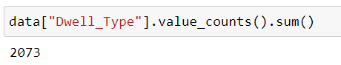
1. DWELL_TYPE
Categorical Variable

Slide 8
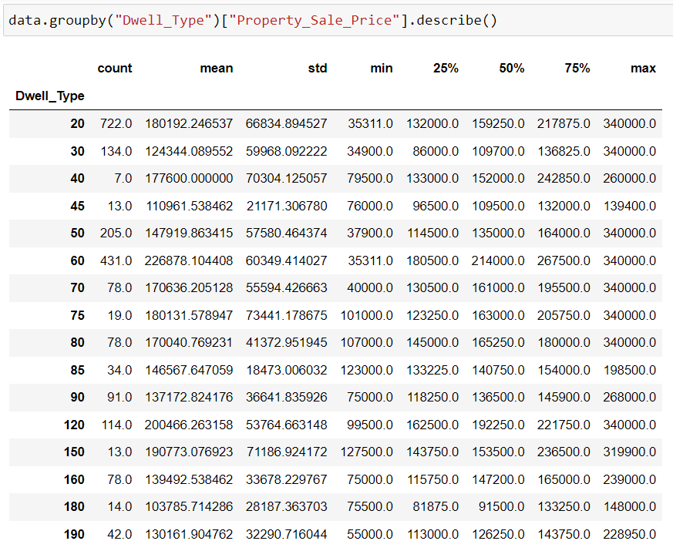
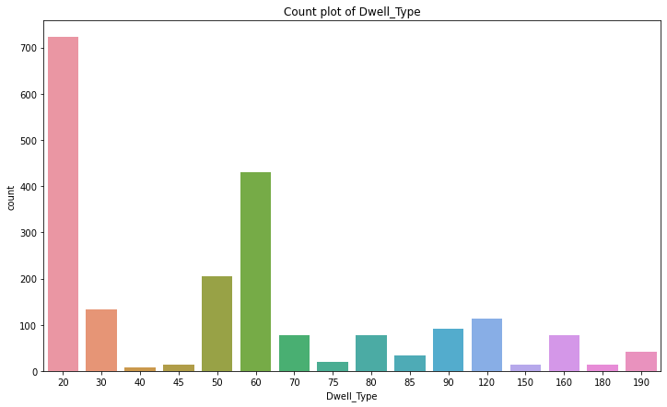

Slide 9
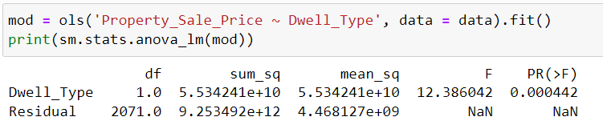
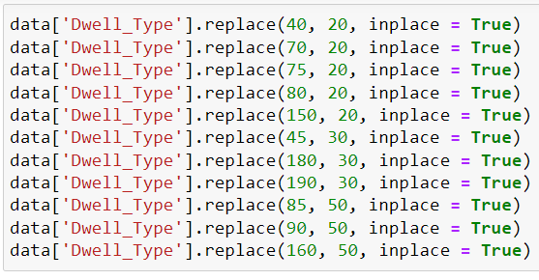
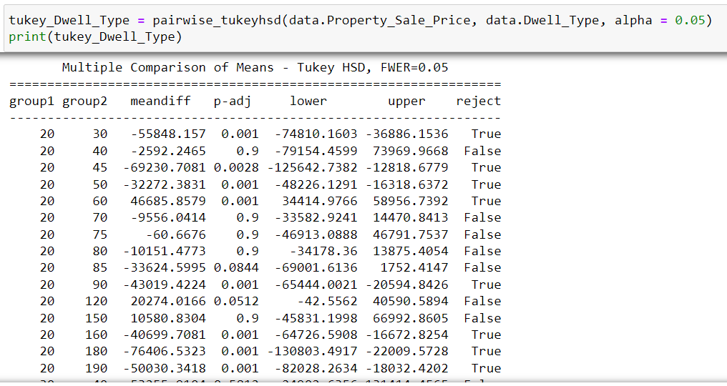
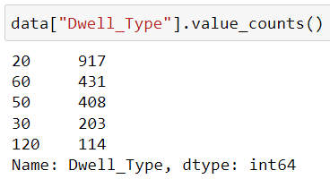
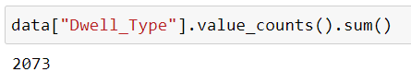

Slide 10
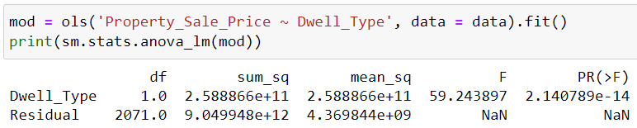
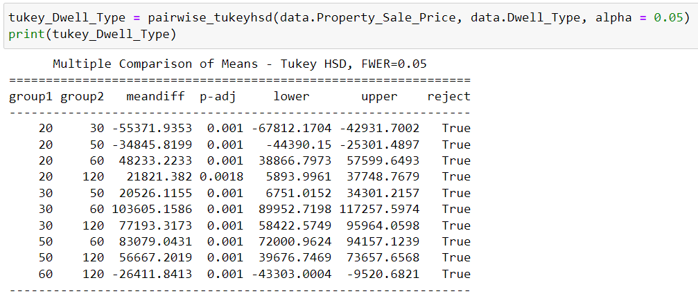
Good Predictors

Slide 11
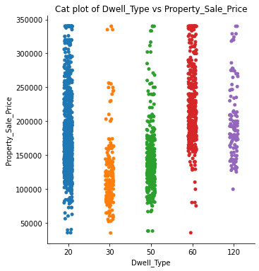
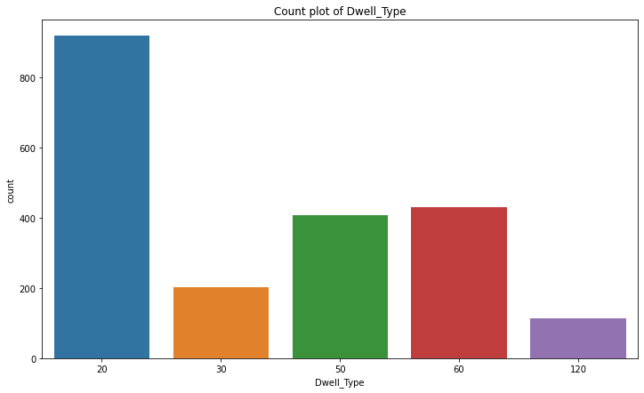

Slide 12
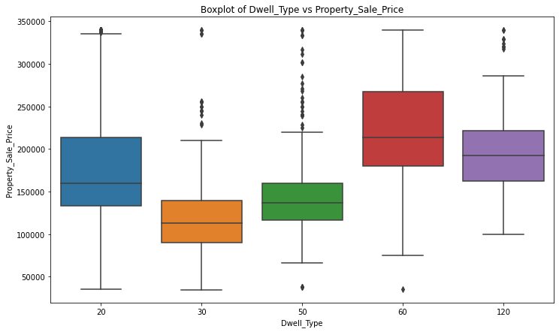

Slide 13
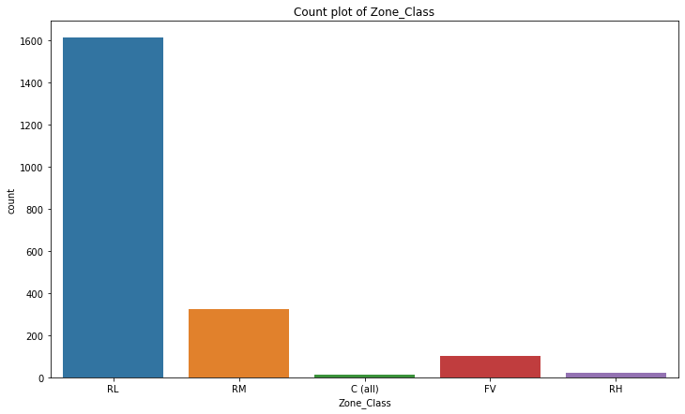
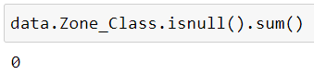
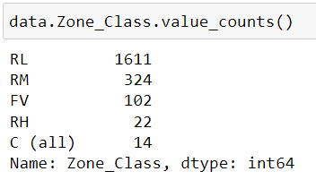
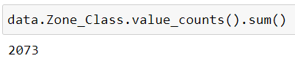
2. ZONE_CLASS
Categorical Variable

Slide 14
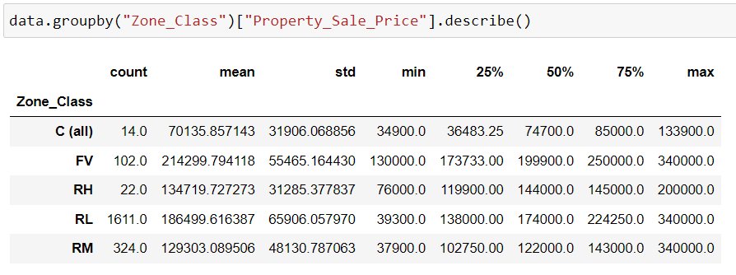
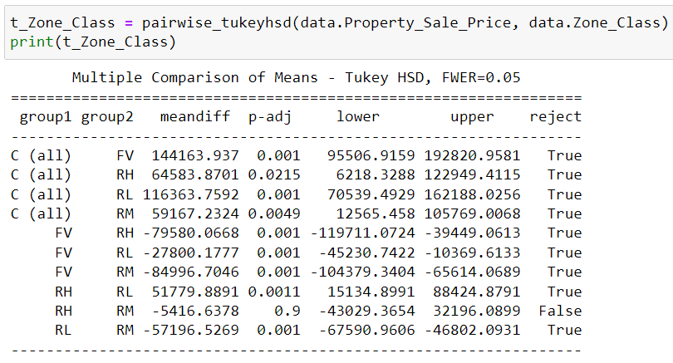
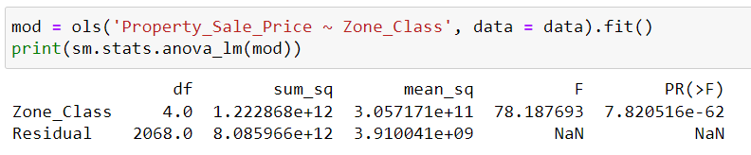

Slide 15
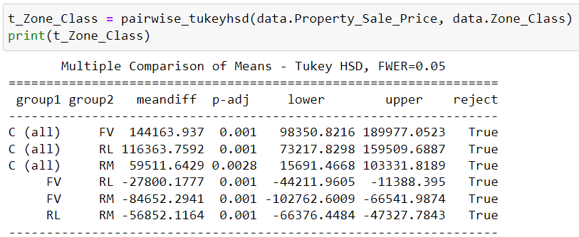
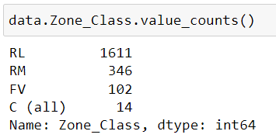
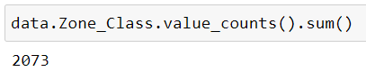
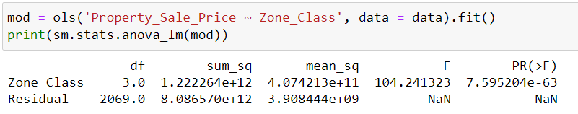
Good Predictor

Slide 16
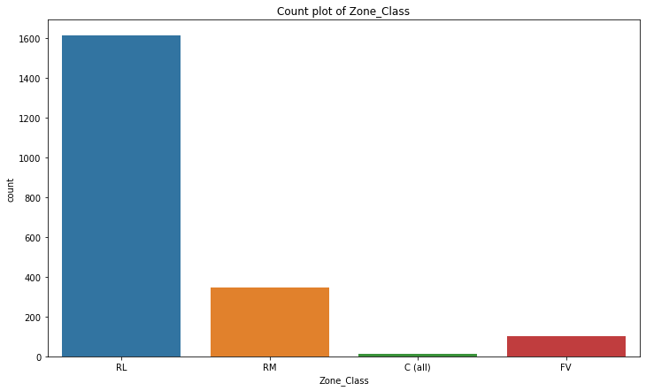
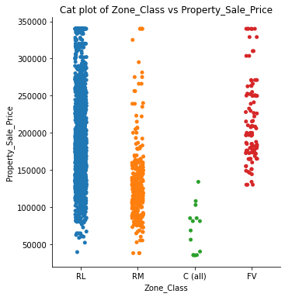

Slide 17
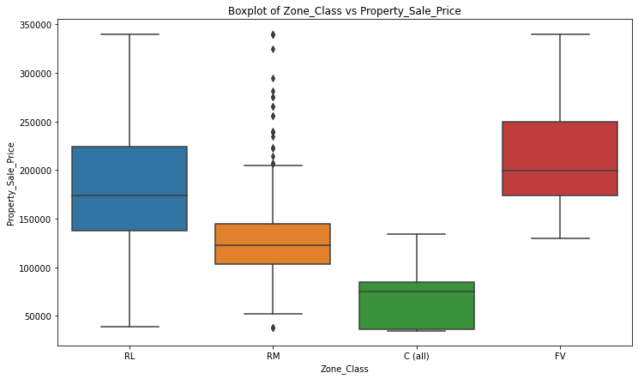

Slide 18
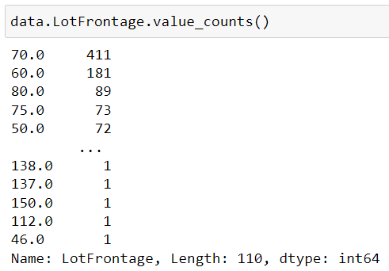
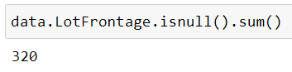
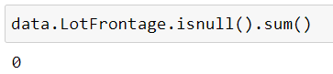
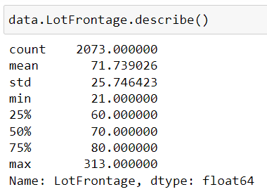
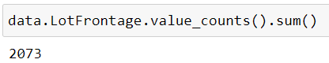
3. LOTFRONTAGE
Continuous Variable

Slide 19
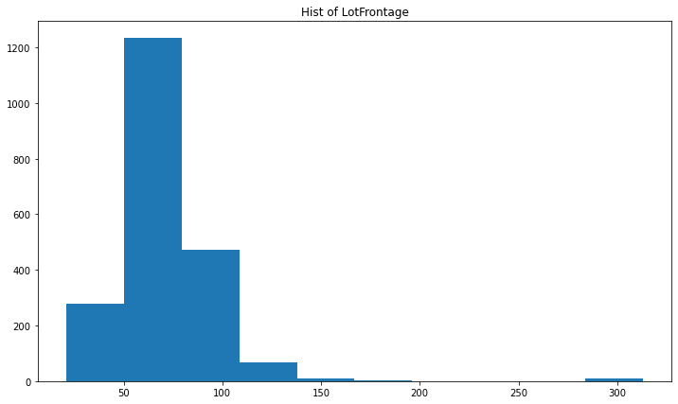
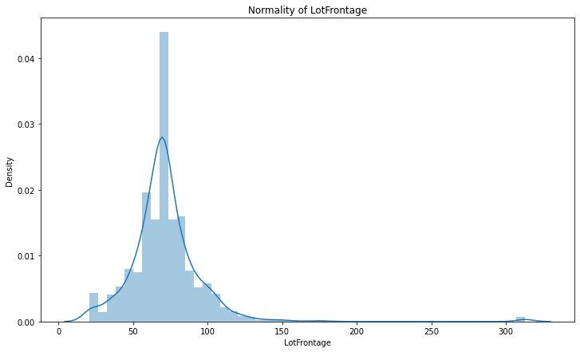

Slide 20
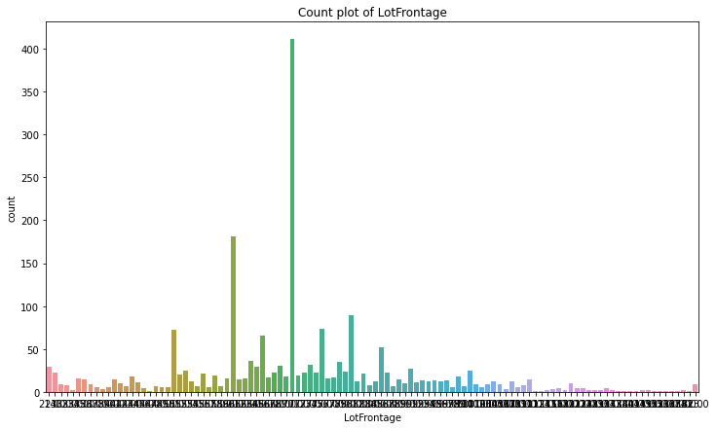
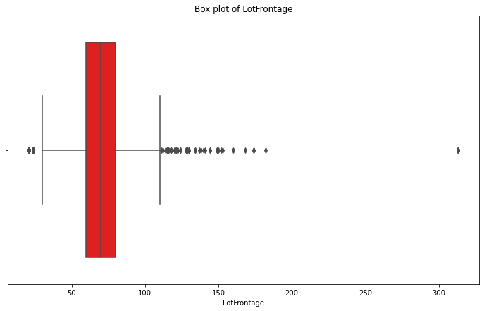

Slide 21





Slide 22



Slide 23


Not Good Predictor

Slide 24




4. LOTAREA
Continuous Variable

Slide 25



Slide 26





Slide 27



Slide 28



Slide 29


Not Good Predictor

Slide 30


5. ROAD_TYPE
Categorical Variable

Slide 31

Good Predictor

Slide 32



6. ALLEY
Categorical Variable

Slide 33





Good Predictor

Slide 34



Slide 35


Slide 36


7. PROPERTY_SHAPE
Categorical Variable

Slide 37





Slide 38



Good Predictors

Slide 39



Slide 40


8. LANDCONTOUR
Categorical Variable

Slide 41


Good Predictors

Slide 42




Slide 43



9. UTILITIES
Categorical Variable
Not Good Predictors

Slide 44



10. LOTCONFIG
Categorical Variable

Slide 45



Good Predictors

Slide 46



Slide 47


11. LANDSLOPE
Categorical Variable

Slide 48

Not Good Predictors

Slide 49


12. NEIGHBORHOOD
Categorical Variable

Slide 50



Good Predictors

Slide 51



Slide 52



Slide 53



13. CONDITION1
Categorical Variable

Slide 54



Good Predictors

Slide 55



Slide 56



14. CONDITION2
Categorical Variable

Slide 57



Good Predictors

Slide 58



Slide 59



15. DWELLING_TYPE
Categorical Variable

Slide 60



Good Predictors

Slide 61



Slide 62



16. HOUSESTYLE
Categorical Variable

Slide 63



Good Predictors

Slide 64



Slide 65


17. OVERALLQUAL
Categorical Variable

Slide 66



Good Predictors

Slide 67




Slide 68


18. OVERALLCOND
Categorical Variable

Slide 69




Good Predictors

Slide 70



Slide 71



19. YEARBUILT
Continuous Variable

Slide 72



Slide 73



Slide 74


Not Good Predictors

Slide 75



20. YearRemodAdd
Continuous Variable

Slide 76



Slide 77


Not Good Predictors

Slide 78



21. RoofStyle
Categorical Variable

Slide 79



Good Predictors

Slide 80



Slide 81



22. RoofMatl
Categorical Variable

Slide 82



Good Predictors

Slide 83



Slide 84



23. Exterior1st
Categorical Variable

Slide 85



Good Predictors

Slide 86



Slide 87


24. Exterior2nd
Categorical Variable

Slide 88



Good Predictors

Slide 89




Slide 90


25. MasVnrType
Categorical Variable

Slide 91



Good Predictors

Slide 92



Slide 93



26. MasVnrArea
Continuous Variable

Slide 94



Slide 95



Slide 96


Not Good Predictors

Slide 97



27. ExterQual
Categorical Variable

Slide 98




Good Predictors

Slide 99



28. ExterCond
Categorical Variable

Slide 100



Good Predictors

Slide 101



Slide 102



29. Foundation
Categorical Variable

Slide 103



Good Predictors

Slide 104



Slide 105



30. BsmtQual
Categorical Variable

Slide 106



Good Predictors

Slide 107



Slide 108



31. BsmtCond
Categorical Variable

Slide 109



Good Predictors

Slide 110



Slide 111



32. BsmtExposure
Categorical Variable

Slide 112



Good Predictors

Slide 113



Slide 114



32. BsmtFinType1
Categorical Variable

Slide 115



Good Predictors

Slide 116



Slide 117



33. BsmtFinSF1
Continuous Variable

Slide 118



Slide 119


Not Good Predictors

Slide 120



33. BsmtFinType2
Categorical Variable

Slide 121



Good Predictors

Slide 122



Slide 123



34. BsmtFinSF2
Continuous Variable

Slide 124


Not Good Predictors

Slide 125



35. BsmtUnfSF
Continuous Variable

Slide 126



Slide 127


Not Good Predictors

Slide 128



36. TotalBsmtSF
Continuous Variable

Slide 129



Slide 130



Good Predictors

Slide 131



37. Heating
Categorical Variable

Slide 132



Good Predictors

Slide 133



Slide 134



38. HeatingQC
Categorical Variable

Slide 135



Good Predictors

Slide 136



Slide 137




39. CentralAir
Categorical Variable
Good Predictors

Slide 138



Slide 139



40. Electrical
Categorical Variable

Slide 140



Good Predictors

Slide 141



Slide 142



41. FirstFlrSF
Continuous Variable

Slide 143



Slide 144



Slide 145


Good Predictors

Slide 146



42. SecondFlrSF
Continuous Variable

Slide 147



Slide 148



Slide 149


Not Good Predictors

Slide 150



43. LowQualFinSF
Continues Variable

Slide 151



Slide 152



Here UL & LL both are 0.
And Also
Corr is also Less
Not Good Predictors

Slide 153



44. GrLivArea
Continuous Variable

Slide 154



Slide 155



Slide 156


Good Predictors

Slide 157


45. BsmtFullBath
Categorical Variable

Slide 158




Good Predictors

Slide 159



Slide 160



46. BsmtHalfBath
Categorical Variable

Slide 161


Not Good Predictors

Slide 162




47. FullBath
Categorical Variable

Slide 163



Good Predictors

Slide 164



Slide 165




48. HalfBath
Categorical Variable

Slide 166



Good Predictors

Slide 167



Slide 168



49. BedroomAbvGr
Categorical Variable

Slide 169



Good Predictors

Slide 170



Slide 171




50. KitchenAbvGr
Categorical Variable

Slide 172



Good Predictors

Slide 173



Slide 174



51. KitchenQual
Categorical Variable

Slide 175



Good Predictors

Slide 176


Slide 177




52. TotRmsAbvGrd
Continuous Variable

Slide 178



Slide 179


Slide 180


Not Good Predictors

Slide 181



53. Functional
Categorical Variable

Slide 182



Good Predictors

Slide 183


Slide 184




54. Fireplaces
Categorical Variable

Slide 185



Good Predictors

Slide 186



Slide 187




55. FireplaceQu
Categorical Variable

Slide 188



Good Predictors

Slide 189



Slide 190




56. GarageType
Categorical Variable

Slide 191



Good Predictors

Slide 192



Slide 193






57. GarageYrBlt
Continuous Variable

Slide 194



Slide 195


Not Good Predictors

Slide 196




58. GarageFinish
Categorical Variable

Slide 197



Good Predictors

Slide 198


Slide 199




59. GarageCars
Categorical Variable

Slide 200



Good Predictors

Slide 201



Slide 202




60. GarageArea
Continuous Variable

Slide 203



Slide 204



Slide 205


Good Predictors

Slide 206




61. GarageQual
Categorical Variable

Slide 207



Good Predictors

Slide 208



Slide 209




62. GarageCond
Categorical Variable

Slide 210



Good Predictors

Slide 211



Slide 212



63. PavedDrive
Categorical Variable

Slide 213



Good Predictors

Slide 214



Slide 215




64. WoodDeckSF
Continuous Variable

Slide 216



Slide 217



Not Good Predictors

Slide 218



65. OpenPorchSF
Continuous Variable

Slide 219



Slide 220



Not Good Predictors

Slide 221



66. EnclosedPorch
Continuous Variable

Slide 222



Slide 223



Not Good Predictors

Slide 224




67. ThrSsnPorch
Continuous Variable

Slide 225



Slide 226


Not Good Predictors

Slide 227



68. ScreenPorch
Continuous Variable

Slide 228



Slide 229


Not Good Predictors

Slide 230



69. PoolArea
Continuous Variable

Slide 231



Slide 232


Not Good Predictors

Slide 233



70. PoolQC
Categorical Variable

Slide 234



Here As Per Statistical test, we See that all categories are False, Means Statistically Same So that,
Not Good Predictors

Slide 235



71. Fence
Categorical Variable

Slide 236



Good Predictors

Slide 237



Slide 238




73. MiscFeature
Categorical Variable

Slide 239



Good Predictors

Slide 240



Slide 241




74. MiscVal
Continuous Variable

Slide 242



Slide 243


Not Good Predictors

Slide 244


75. MoSold
Categorical Variable

Slide 245



Slide 246

Here as per we discussed before Statistical test, we See that all categories are False, Means Statistically Same So that,
Not Good Predictors

Slide 247



76. YrSold
Categorical Variable

Slide 248


Again, Statistical test, we See that all categories are False, Means Statistically Same So that,
Not Good Predictors

Slide 249



77. SaleType
Categorical Variable

Slide 250



Good Predictors

Slide 251



Slide 252



78. SaleCondition
Categorical Variable

Slide 253



Good Predictors

Slide 254



Slide 255
Good Predictor As per P-Value
Dewll_Type
one_Class
Road_Type
Alley
Proparty_Shape
LandContour
LotConfig
Neighborhood
Condition1
Condition2
Dwelling_Type
HouseStyle
OverallQual
OverallCond
RoofStyle
RoofMatl
Exterior1st
Exterior2nd
MasVnrType
ExterQual
ExterCond
Foundation
BsmtQual
BsmtCond
BsmtExposure
BsmtFinType1
BsmtFinType2
TotalBsmtSF
Heating
HeatingQC
CentralAir
Electrical
FirstFlrSF
GrLivArea
BsmtFullBath
FullBath
HalfBath
BedroomAbvGr
KitchenAbvGr
KitchenQual
Functional
Fireplaces
FireplaceQu
GarageType
GarageFinish
GarageCars
GarageArea
GarageQual
GarageCond
PavedDrive
Fence
MiscFeature
SaleType
SaleCondition

Slide 256
Not Good Predictor As per P-Value
LotFrontage
LotArea
Utilities
LandSlope
YearBuilt
YearRemodAdd
MasVnrArea
BsmtFinSF1
BsmtFinSF2
BsmtUnfSF
SecondFlrSF
LowQualFinSF
BsmtHalfBath
TotRmsAbvGrd
GarageYrBlt
WoodDeckSF
OpenPorchSF
EnclosedPorch
ThrSsnPorch
ScreenPorch
PoolArea
PoolQC
MiscVal
MoSold
YrSold

Slide 257

OLS Model With Good predictor

Slide 258


Slide 259


Slide 260


Slide 261

OLS Model With P <= 0.05

Slide 262


Slide 263


Slide 264

H
E
A
T
M
A
P
OF
C
O
R
R
E
L
A
T
I
O
N

Slide 265


Predictions on test data and Residuals

Slide 266
Linear Regression Assumptions (Health Check)

Slide 267

Normality

Slide 268

Linearity

Slide 269


Slide 270

Independence of observation

Slide 271

Constant Error Variance [homoscadasticity]

Slide 272

VIF

Slide 273




RMSE: the final verdict!

Slide 274

Plot

Slide 275

Thank You So Much

